Slide 1
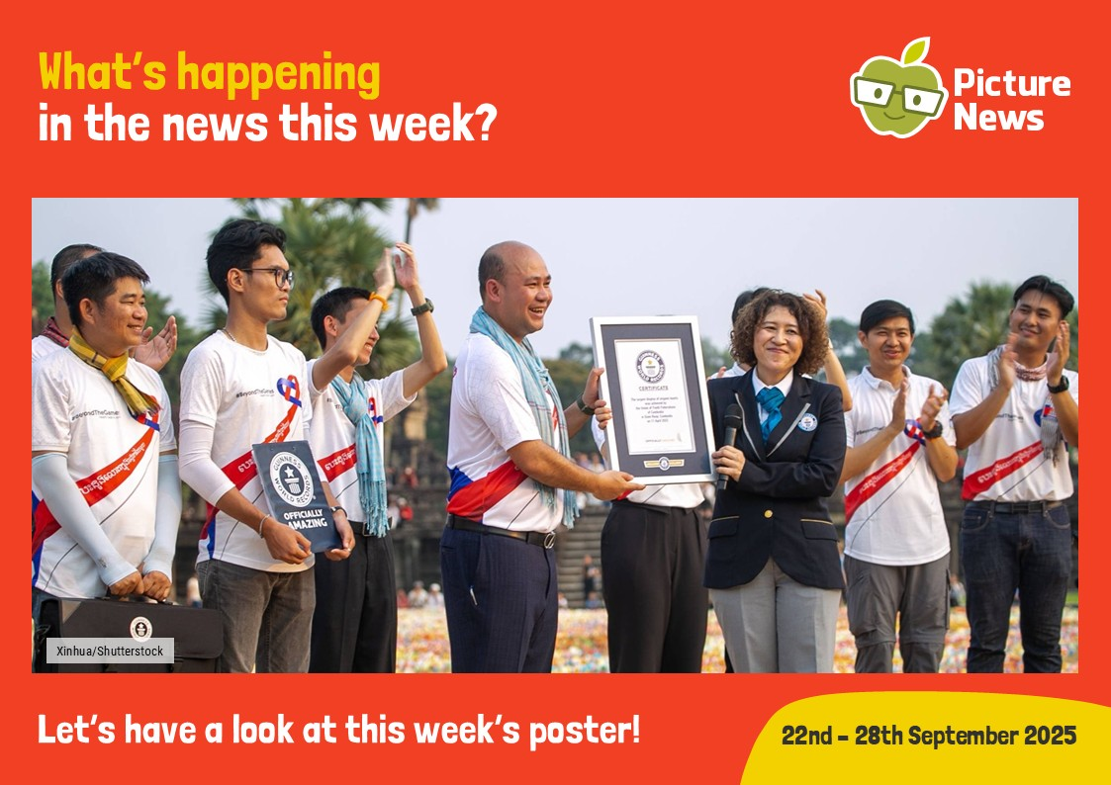

Slide 2
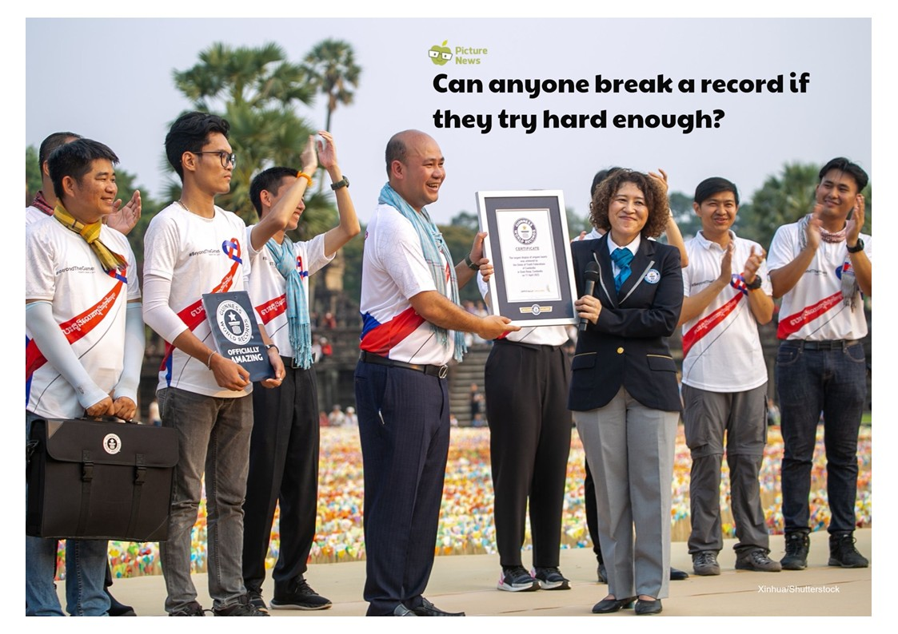

Slide 3
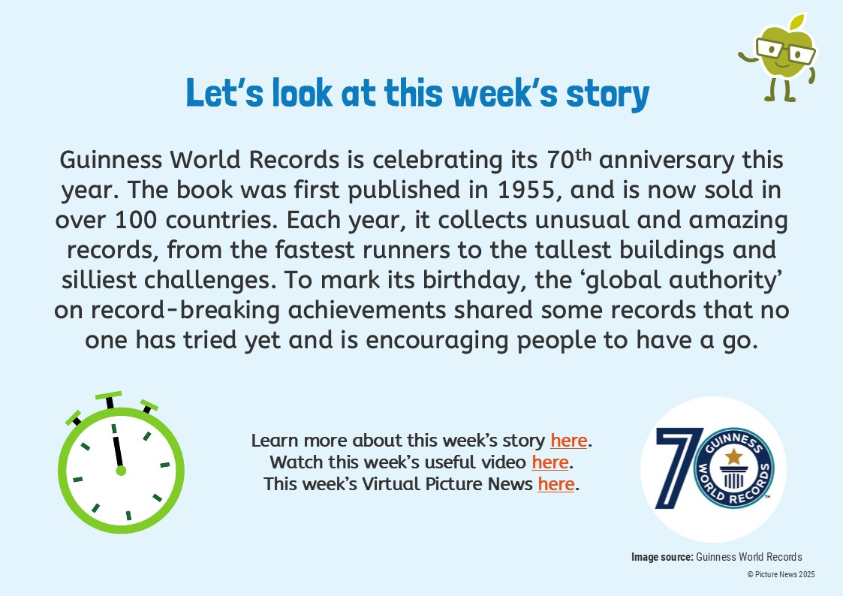

Slide 4
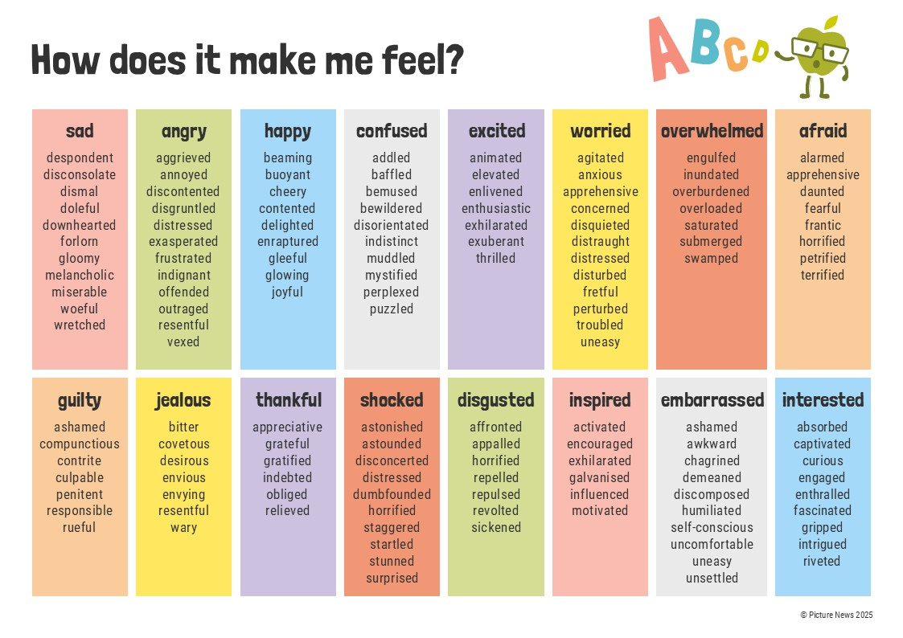

Slide 5
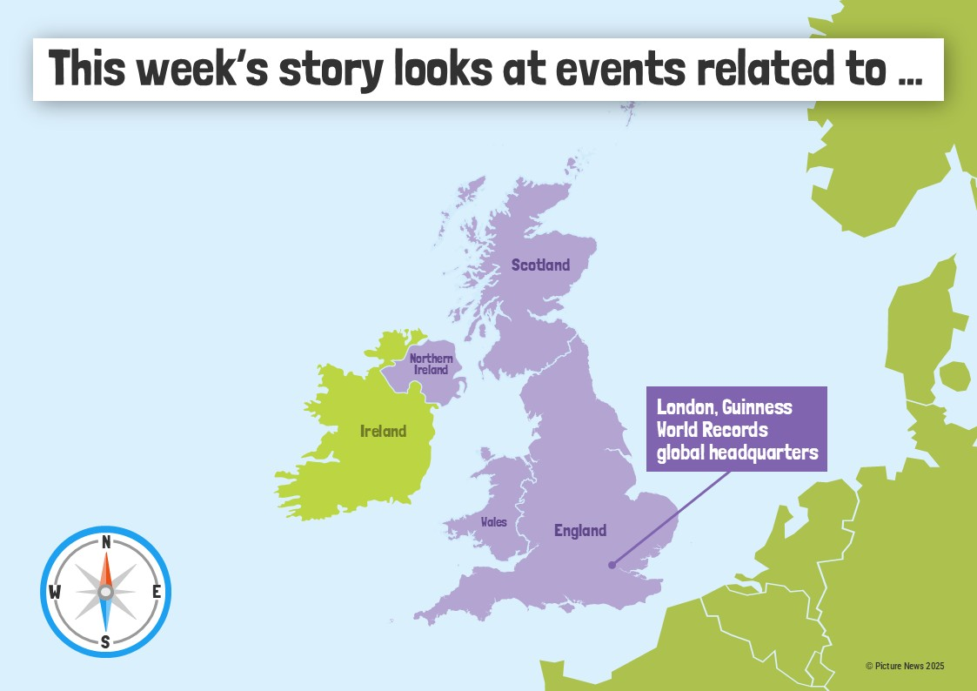

Slide 6
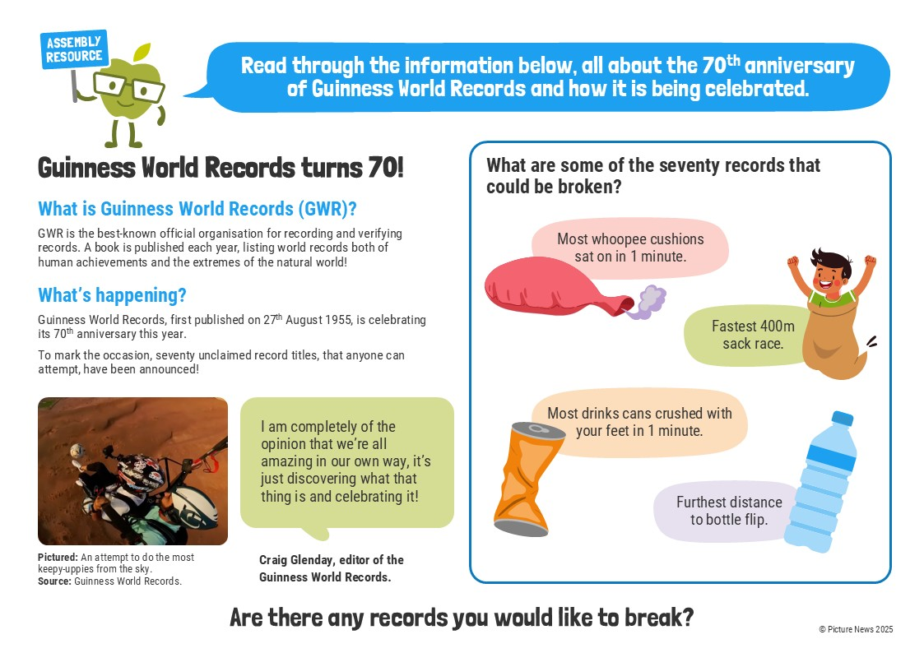

Slide 7
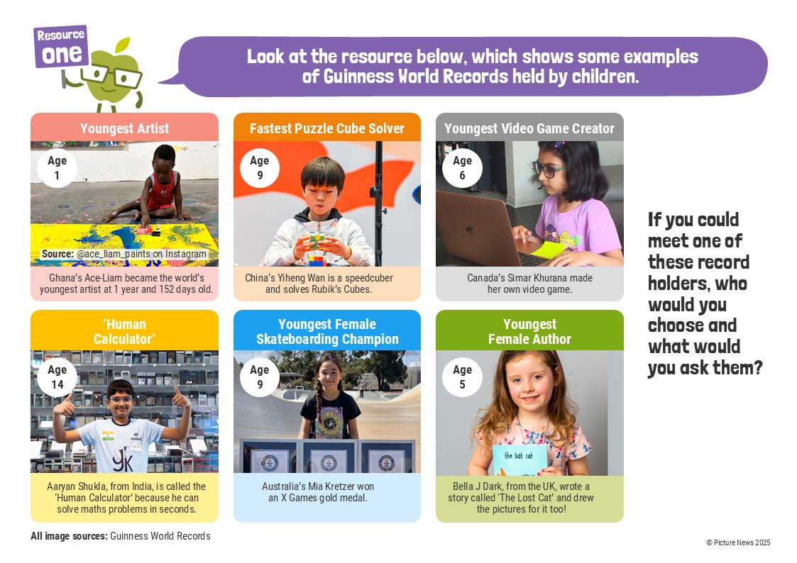

Slide 8
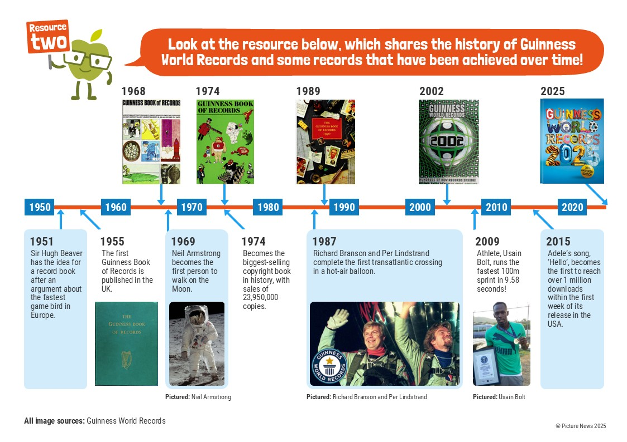

Slide 9

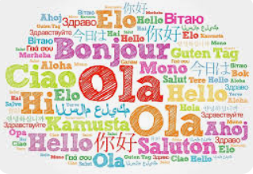
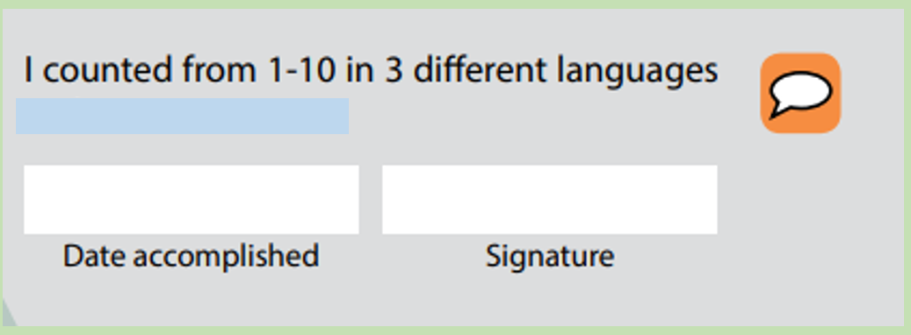
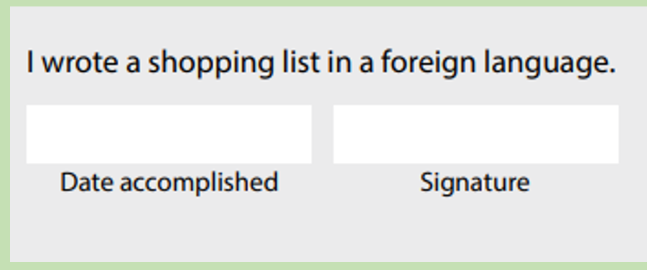
The Guinness Book of World Records has been translated into over 40 different languages!
KS2, we hope you enjoy taking part in different Language Challenges during your MFL lesson this week.
We will display them all for Friday.
Will we show our value of Belonging and work as a team to complete all the challenges?
Can you find out which country holds the record for being home to the most living languages?

Slide 10
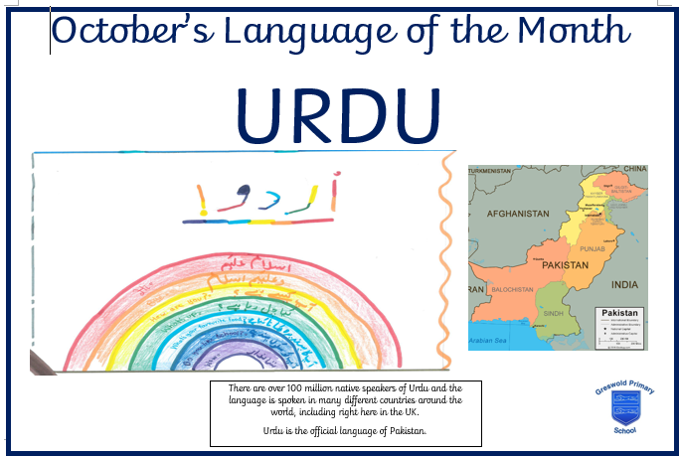
Entries to your class teacher by Monday 29th September!
Remember to enter this year’s Language of the Month Poster competition!
For inspiration ... 2024’s October poster by Esha from Willows.

Slide 12
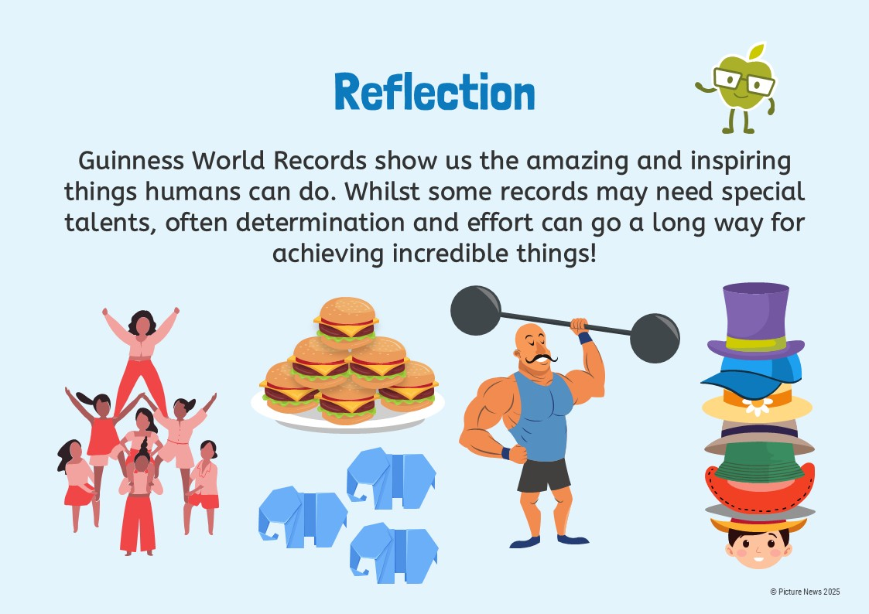

Slide 13
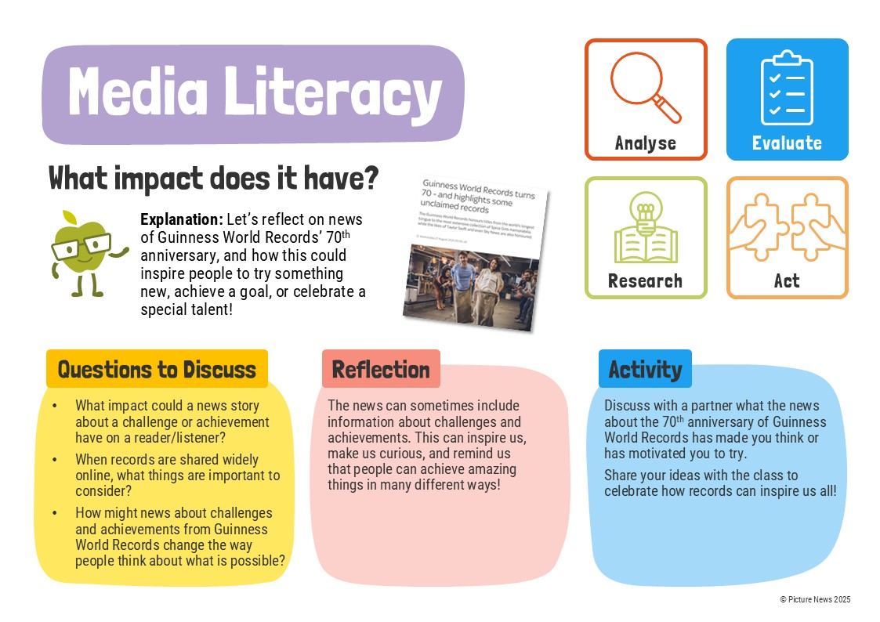

Slide 14


Slide 15
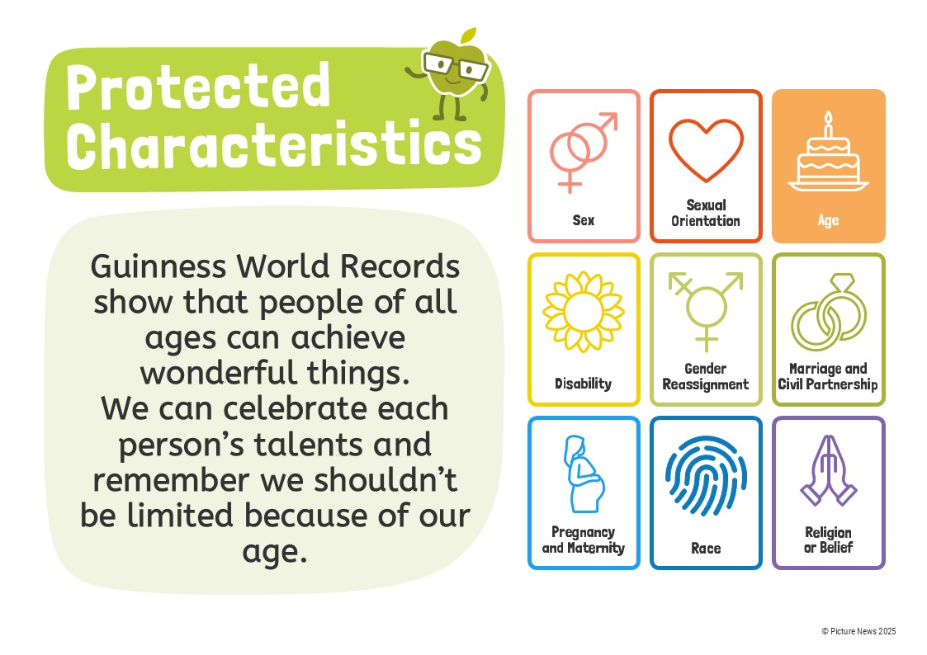

Slide 16
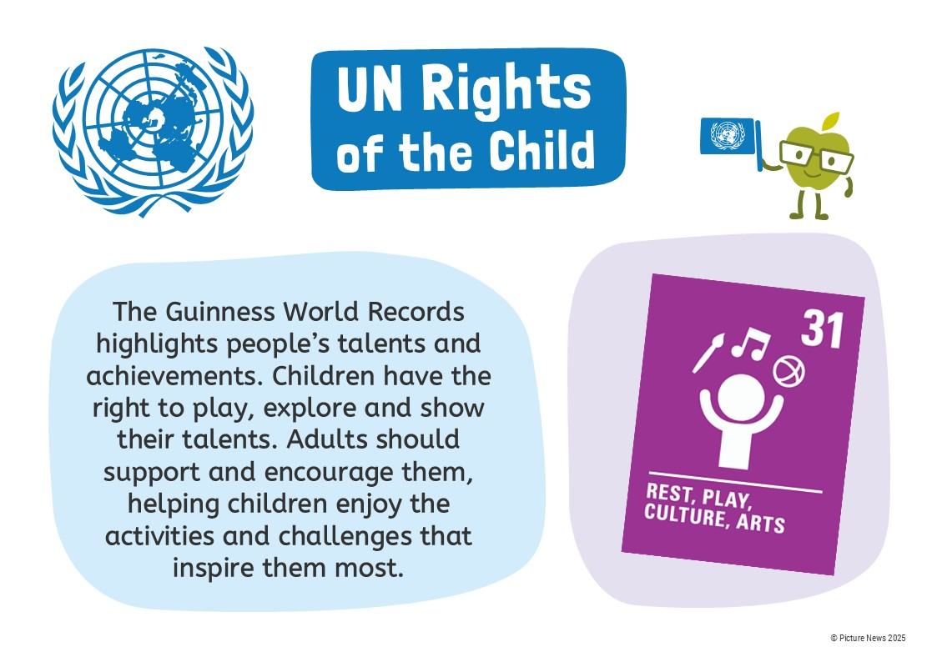

Slide 17
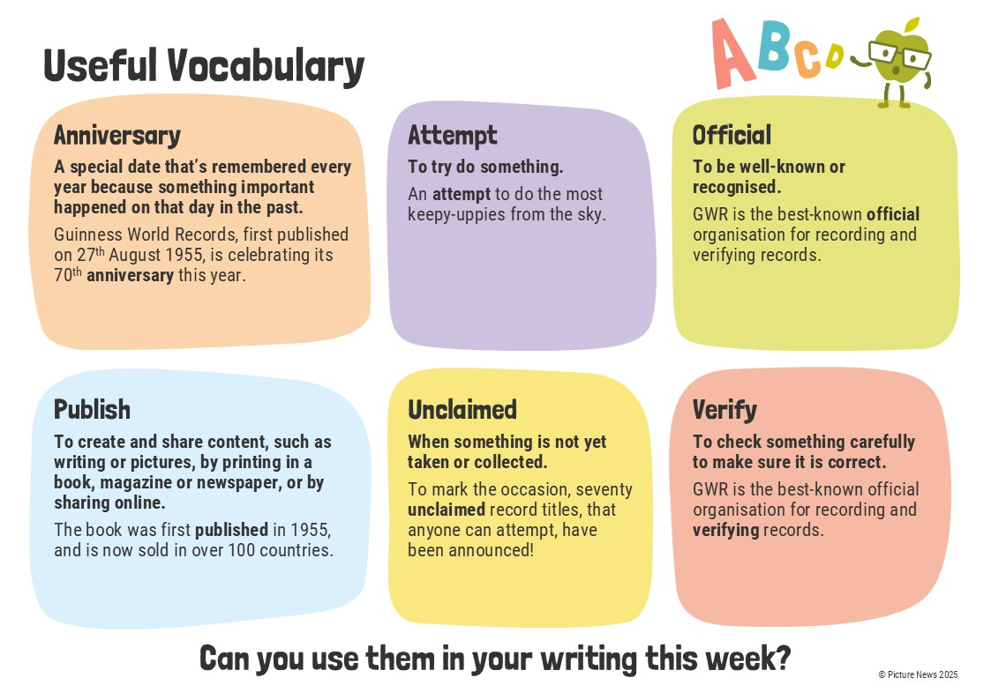

Slide 18
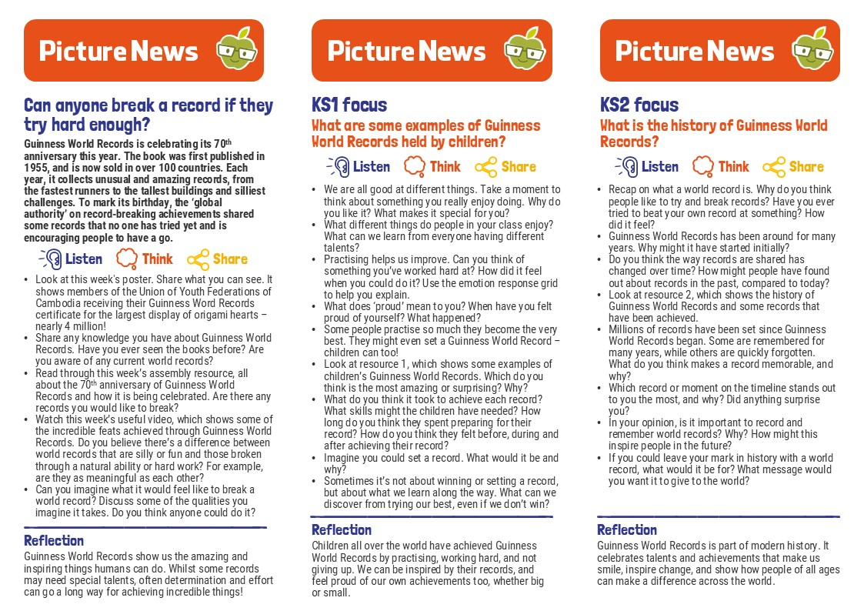

Slide 19
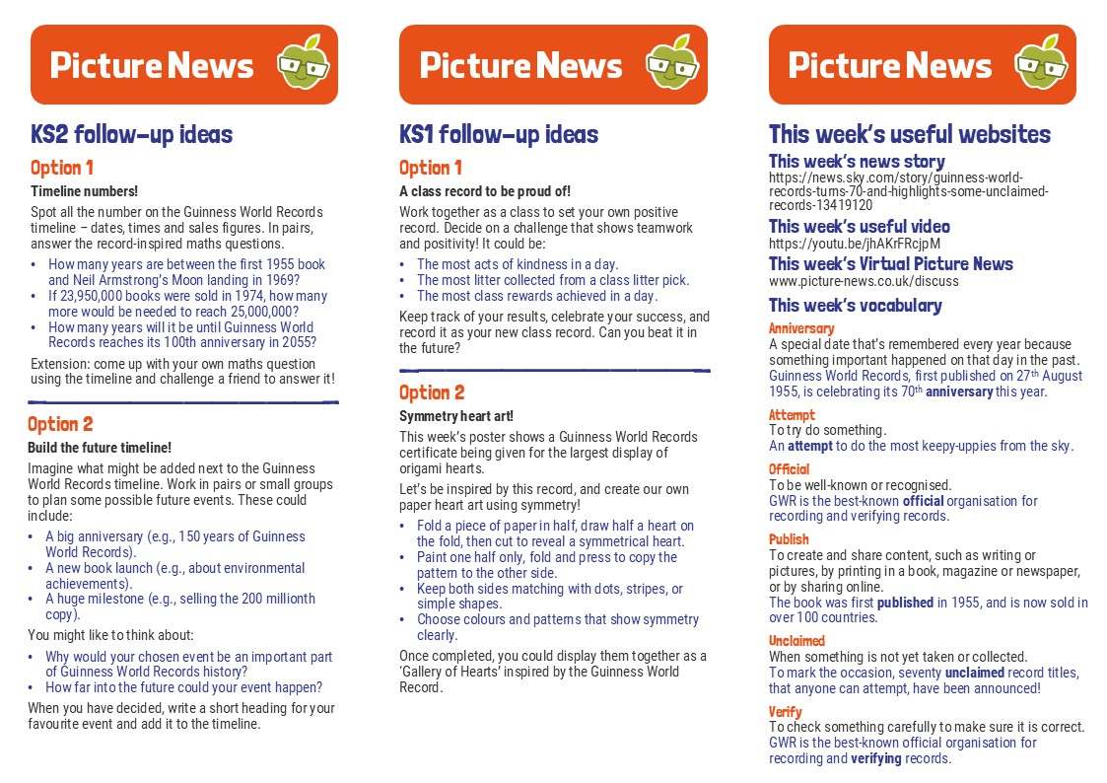
\\

Slide 20
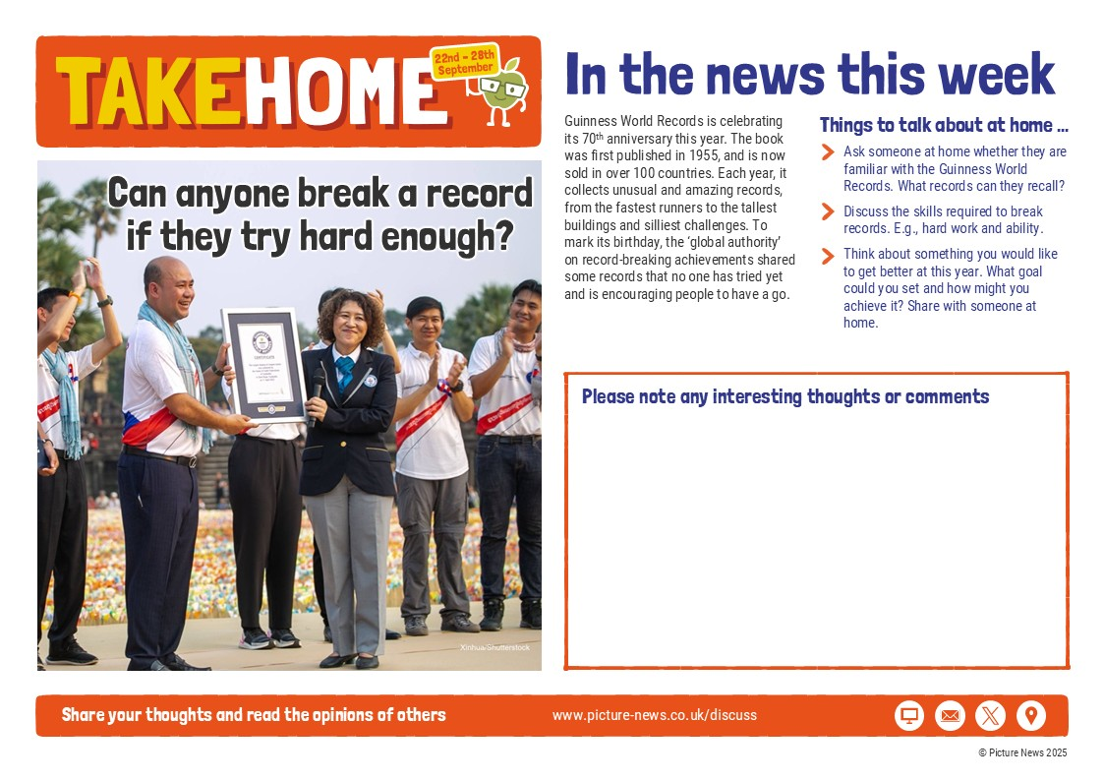

Slide 21
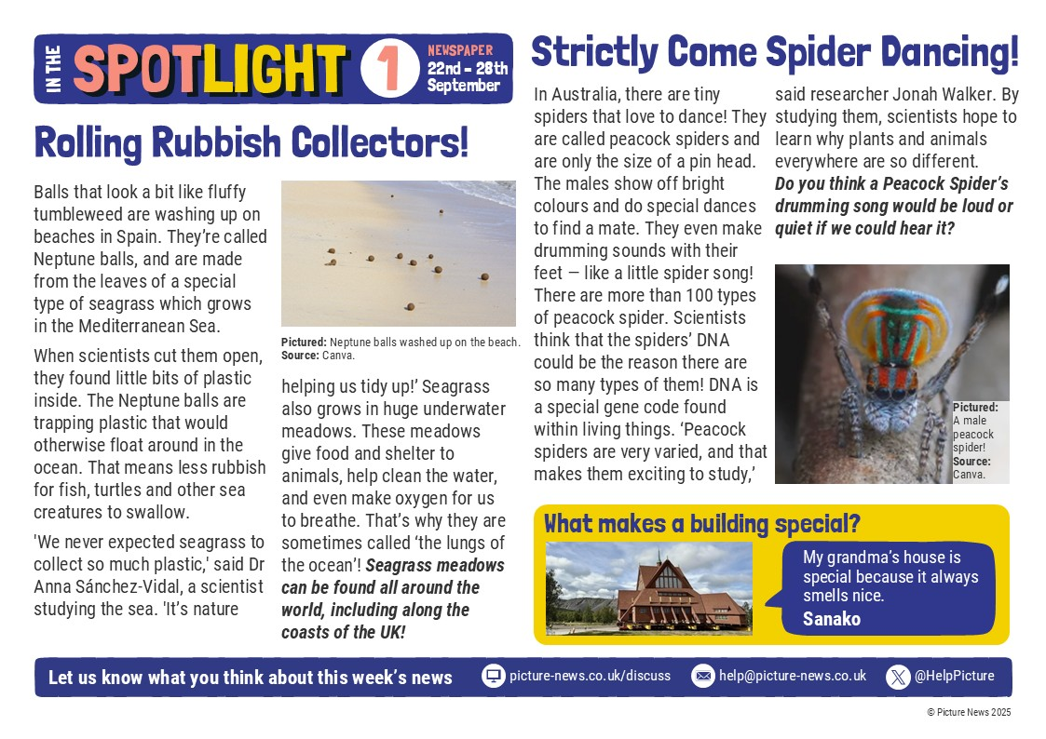

Slide 22


