Slide 1
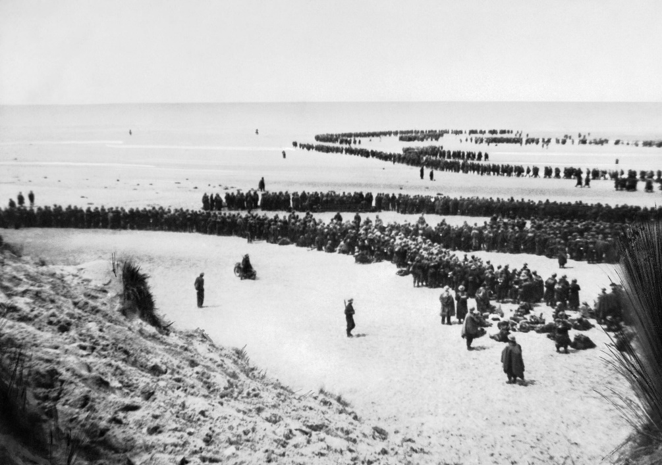
The Battle of Dunkirk
The 26th of May to the 4th of June 1940
British and French troops were stationed in Dunkirk, located on the coast of France. The German Army had successfully invaded mainland France and were closing in on the Allied forces, making it imperative for them to evacuate.
Despite initial predictions that only approximately 30,000 men could be rescued, they managed to save more than 300,000 British and French soldiers; this is due to brave British civilians offering to sail their own boats across the channel to help with this mission. Around 90,000 soldiers were left at Dunkirk which was later captured by the German Army.
Discussion Questions
What happened to the men who were left behind?
British soldiers wait to be evacuated from Dunkirk.
Unknown author, public domain, via Wikimedia Commons

Slide 2
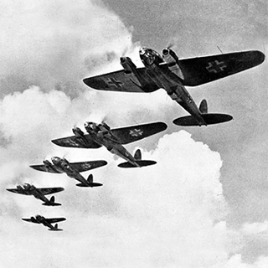
The Battle of Britain
The 10th of July to the 31st of October 1940
This was a terrifying clash between the German Luftwaffe (airforce) and the British Royal Air Force (RAF). The Luftwaffe began by targeting shipping ports along the English channel. Then, they bombed airfields throughout the country and began to bomb British cities and factories. However, the RAF were eventually able to repel the Luftwaffe and deny them control of British airspace.
The Luftwaffe during The Battle of Britain.
Discussion Questions
Why would the Luftwaffe target British cities?
RaminusFalcon, public domain, via Wikimedia Commons

Slide 3
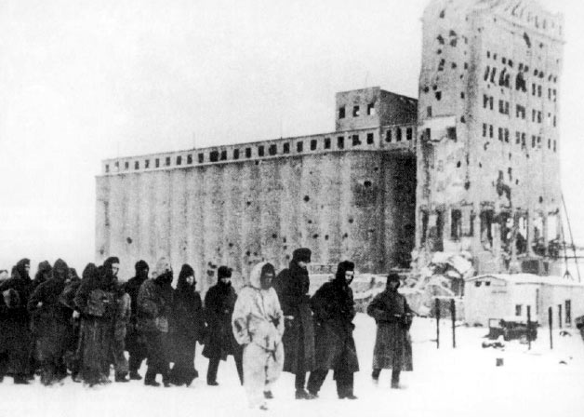
The Battle of Stalingrad
The 17th of July 1942 to the 2nd of February 1943
Hitler wanted to capture Stalingrad for three main reasons: it was named after Joseph Stalin - the leader of the Soviet Union; it was a city full of ammunition factories that supplied the Red Army and finally, it provided access to vital shipping routes via the Volga River.
For similar reasons, Stalin was determined that this city would not fall under German control. As a result, a fierce city battle occurred where troops fought in very close proximity and endured bombing raids from above. Russia’s harsh winter and problems finding enough German and Italian soldiers to continue fighting this battle led to an eventual Soviet victory.
Discussion Questions
Why would Hitler attempt to invade Russia in the first place?
German soldiers (captured during the Battle of Stalingrad) being led to gulags (Russian forced-labour camps).
Not mentioned, Soviet military personnel, public domain, via Wikimedia Commons

Slide 4
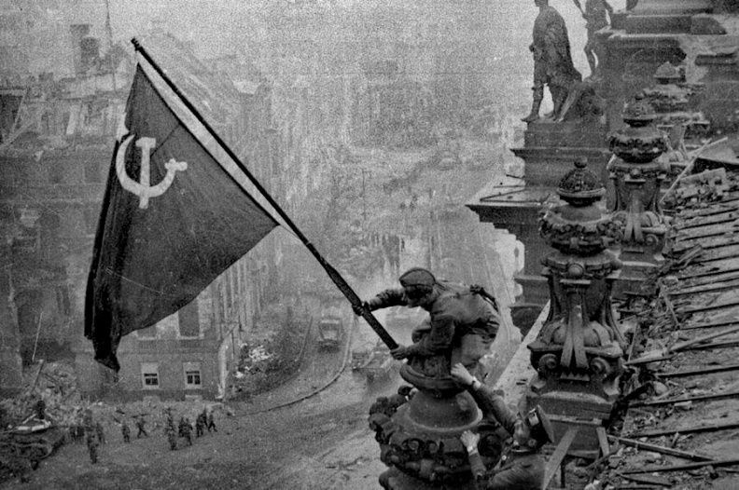
The Battle of Berlin
The 16th of April to the 2nd of May 1945
This was predominantly a clash between the German Army and the Red Army of the Soviet Union. By this point, the German Army had been largely weakened and many soldiers were sick or wounded. By contrast, the Red Army was incredibly large.
The battle involved Soviet bombing raids of the city, along with a ground invasion. Due to this battle occuring in a city, German tanks were paralysed and quite ineffective. Knowing Berlin was soon going to fall, Hitler committed suicide on the 30th of April. The Soviet Union claimed victory by the start of May.
Discussion Questions
Why didn’t Adolf Hitler surrender?
The Soviet Red Army raises their flag over the German Reichstag, declaring victory.
Mil.ru, public domain, via Wikimedia Commons

