Slide 2
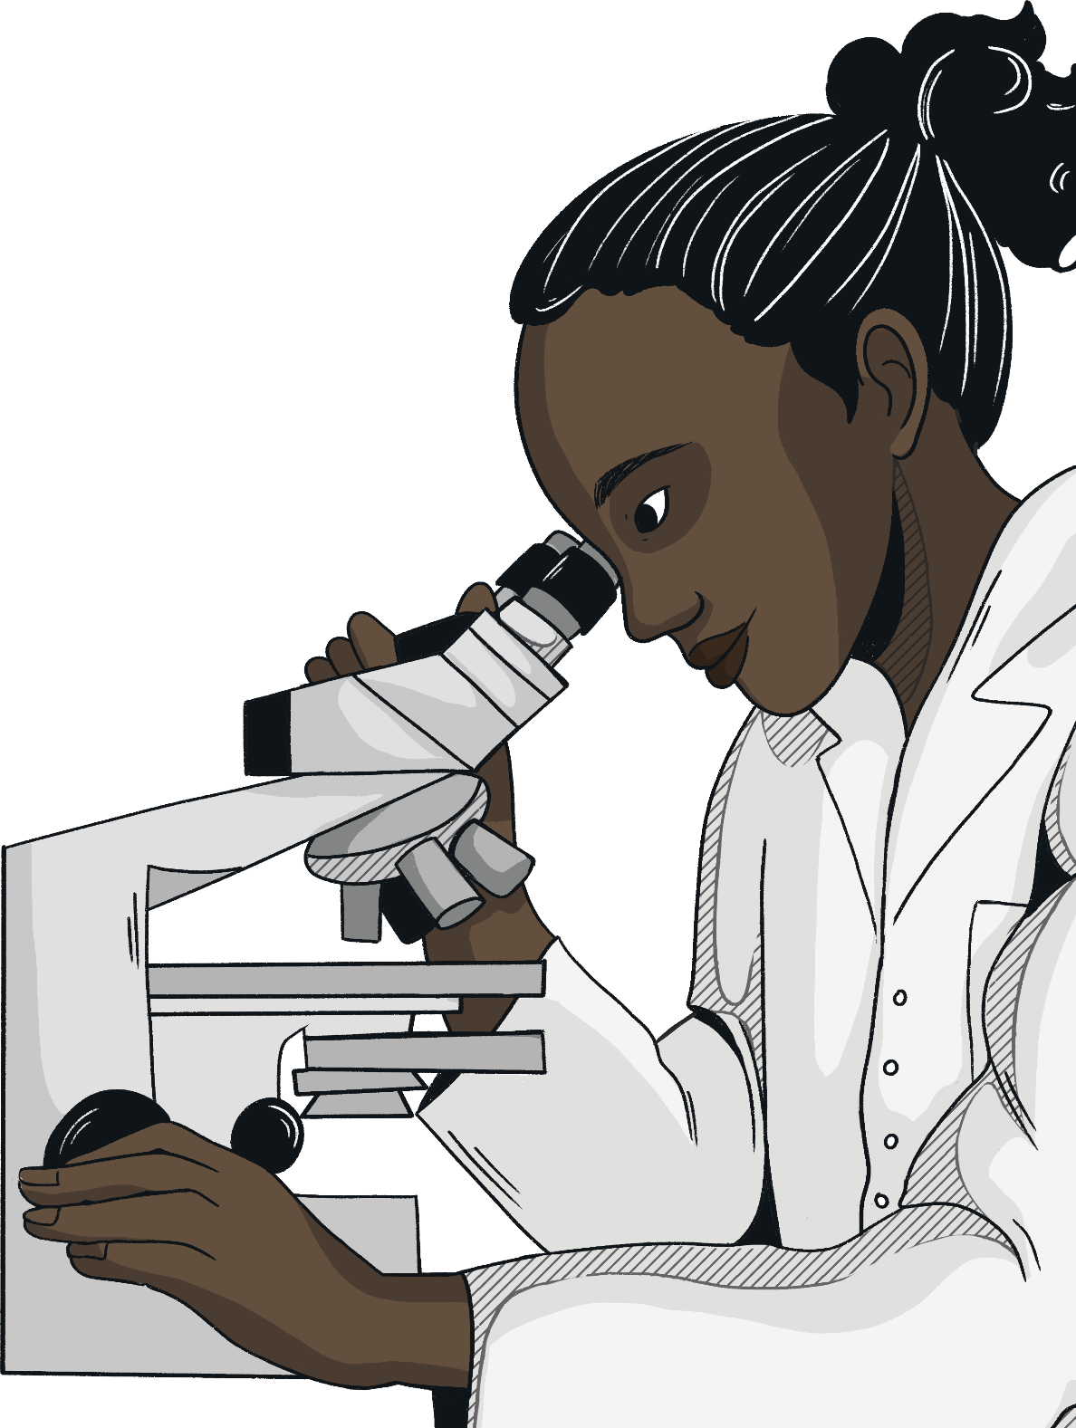
Why Work in Science?
Science is constantly changing - there are always new developments and discoveries to be made.
How exciting would it be to be a part of that?
Science is essential to modern life -
the way we live, produce food and
develop medicines are all a result
of science.
Science is worldwide - you
could have opportunities
to travel the world and
work with specialists from
other countries.

Slide 3
What Are the Different Areas of Science?
You may already be aware from your science lessons that there are three main types of sciences, with lots of other specialisms stemming from them.
biology: From the Greek words ‘bios’ meaning life and ‘logos’ meaning study, it is defined as the science of life and living organisms.
chemistry: The area of science that deals with the structure of elements and compounds, how they can change and how their
energy changes.
physics: The branch of science that deals with matter and energy and the way they act on each other in heat, light, electricity,
and sound.

Slide 4
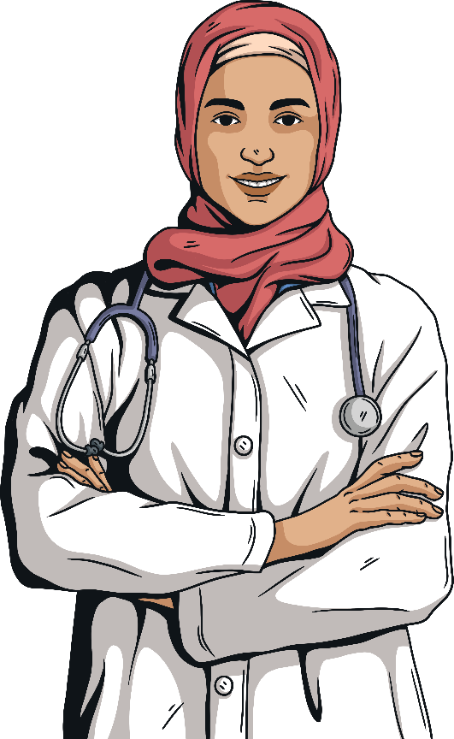
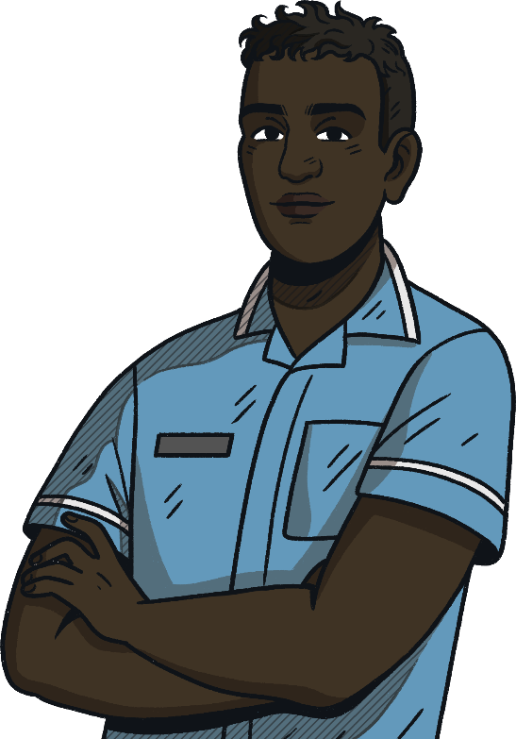
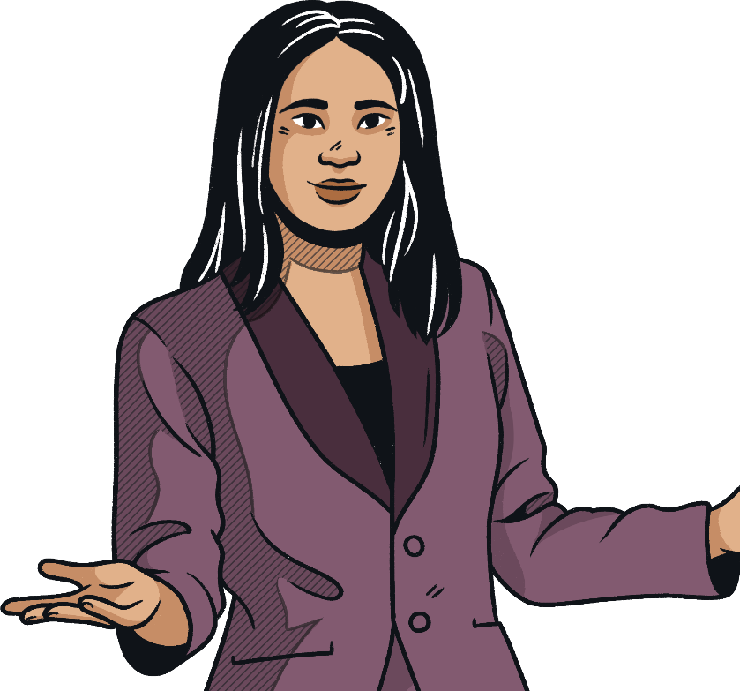
Careers in Science
There are some careers that have an obvious link to science, such as:
Doctor
Nurse
Science Teacher
However, some are more specialised than others and you may not have considered them as a potential career!

Slide 5
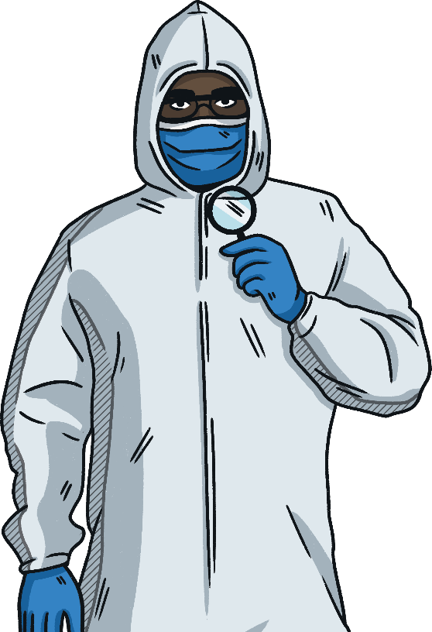
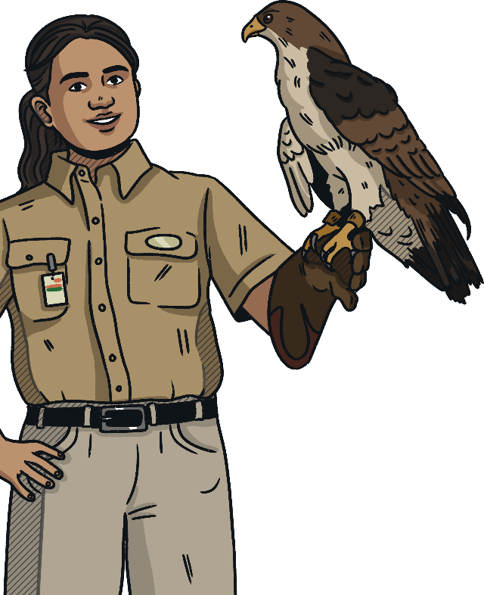
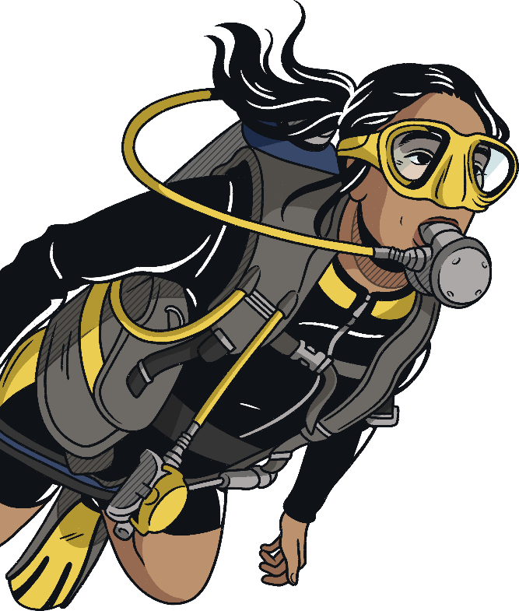
Careers in Biology
A career in biology could be perfect for you if you enjoy the study of nature or living things.
Click on a picture to learn more about each career.
Forensic Scientist
Zoo Keeper
Marine Biologist

Slide 6
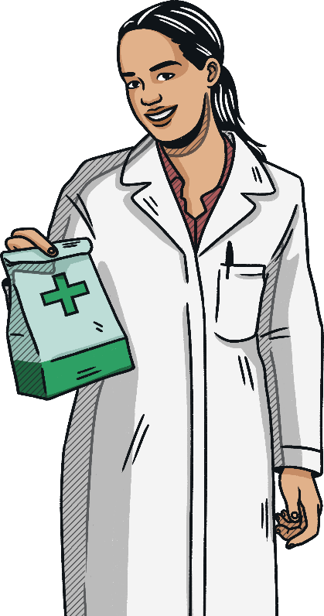
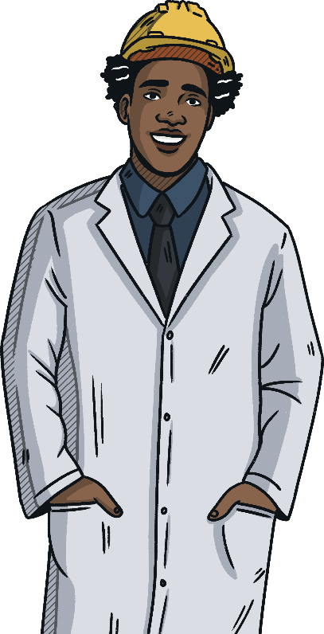
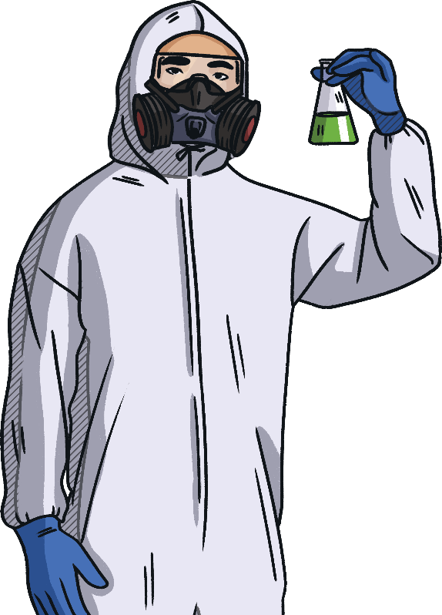
Careers in Chemistry
A career in chemistry could be perfect for you if you enjoy working with chemicals or conducting experiments.
Click on a picture to learn more about each career.
Pharmacist
Materials Engineer
Toxicologist

Slide 7
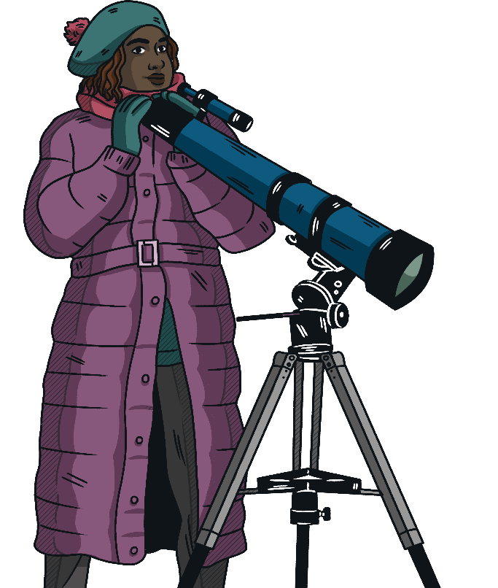
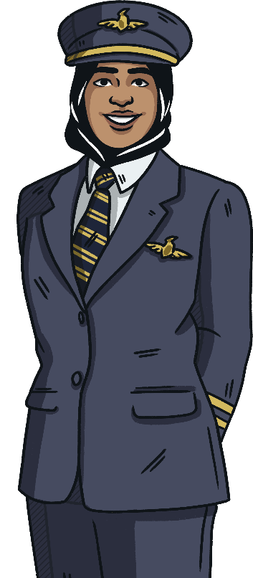
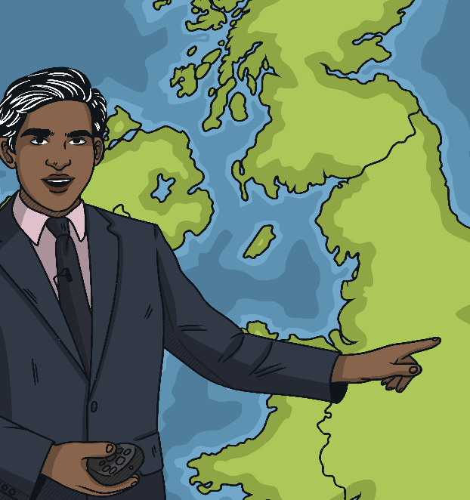
Careers in Physics
A career in physics could be perfect for you if you enjoy the study of space and matter.
Click on a picture to learn more about each career.
Astronomer
Pilot
Meteorologist

Slide 8


Forensic Scientist
Back
Forensic scientists work closely with the police to find scientific evidence that can be used in a court of law. You'll be looking for and examining things associated with crimes.
This could include:
blood and other body fluids
hairs
clothing fibres
paint and glass fragments
tyre marks
flammable substances used to start fires
This evidence is usually presented in writing as a formal statement or report. However, you may have to attend court to give your evidence in person as an expert witness.
Salary
Between £20,000 and £45,000, depending on experience.
Qualifications
A degree in forensic science or biology.

Slide 9

Zoo Keeper
Back
As a zookeeper, you'll need to:
keep animal enclosures clean and safe for the animals and visitors
prepare food and administer medications
design, build and repair environments that are as close to natural habitats as possible
come up with creative ideas for enrichment to keep animals active and interested in
their environments
work with other professionals, such as vets
educate visitors by sharing your animal knowledge, through demonstrations with live animals, talks, tours and visitor experiences
assist with breeding procedures and raising young animals, particularly
endangered species
Salary
Between £12,000 and £25,000, depending on experience.
Qualifications
A degree in zoology or a life science.

Slide 10
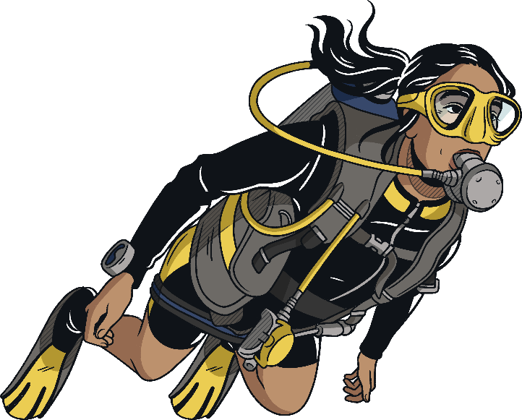
Marine Biologist
Back
Marine biology is the study of organisms and ecosystems in the oceans and other saltwater environments. This includes studying marine plants, animals and other organisms in deep oceans, shallow seas and laboratories.
The main aims of marine biology are to improve understanding of the marine world and to understand and predict changes in ecosystems that are affected by human and natural disturbances.
Marine biology is a broad-ranging career. You could go into field work, academic research, laboratory work, consulting, charity, outreach or policy making.
Salary
Between £12,000 and £120,000 a year, depending on experience and qualifications.
Qualifications
A degree in marine biology or ocean and earth science.

Slide 11

Pharmacist
Back
As a pharmacist, you'll be responsible for dispensing and supplying prescription medicines.
You'll also be involved in maintaining and improving people's health by providing advice and information.
You'll sell over-the-counter medical products and help people understand how to use medicines and medical appliances.
You will usually be based in high street or independent pharmacies of various sizes. Alternatively, you might work in a doctor's practice or health centre.
Salary
Between £16,000 and £70,000 a year, depending on experience and qualifications.
Qualifications
A masters degree in pharmacy and registration with the General Pharmaceutical Council (GPhC).

Slide 12

Materials Engineer
Back
As a materials engineer, you'll work with lots of different materials to improve their performance or you’ll create new materials to help advance technologies or products.
You'll need an understanding of the properties of different substances, from raw materials to finished products. You might work with a range of materials like ceramics, plastics, polymers or industrial minerals.
There's always a need for materials to have better durability or strength and to be more cost effective so you could work in a range of industries, such as energy companies, sports equipment manufacturers or biomedical engineering, where you could help in developing artificial body parts!
Salary
Between £20,000 and £60,000 a year, depending on experience and qualifications.
Qualifications
A degree in chemistry or technology, specifically materials engineering.

Slide 13

Toxicologist
Back
Toxicologists investigate any potential negative impact that materials, chemicals, medicines, natural substances and radiation might have on human and animal health or the environment.
You'll plan and carry out laboratory studies and field studies to assess the possible risks and harmful effects of these substances.
You'll also work to understand and manage the risks that chemicals pose depending on different scenarios.
If you choose to work within the NHS, you could be involved in laboratory analysis or the diagnosis of poisoning and drug overdose (in order to help advise on the treatment of affected patients).
Salary
Between £20,000 and £90,000 a year, depending on experience and qualifications.
Qualifications
A degree in biological, biomedical or biochemical sciences.

Slide 14

Astronomer
Back
Astronomers are scientists who study the origin of the universe and how it works.
As an astronomer, you can work in observational astronomy, using telescopes and cameras to look at the stars, galaxies and other astronomical objects, or in theoretical astronomy, where you'll use maths and computer models to explain observations and predictions.
You could choose to specialise in studying planets, stars, galaxies or cosmology (the origin of the universe).
Most modern research in astronomy involves significant computer programming and modelling so you need to be good with computers too.
Salary
Between £28,000 and £75,000 a year, depending on experience and qualifications.
Qualifications
Almost all astronomy jobs require a PhD (or at least for you to be working towards one) in astrophysics or space/planetary science.

Slide 15

Pilot
Back
As an airline pilot, you'll fly passengers or cargo on long or short-haul flights.
There are usually two pilots on each flight and they will usually take turns to fly the plane to avoid tiredness. One operates the controls while the other speaks to air traffic control and completes the paperwork.
The captain has overall responsibility for the safe and efficient operation of the aircraft and the safety of crew and passengers.
You have to pass stringent training courses, followed by recurrent training every six months, in order to maintain the relevant licence required for the job.
Salary
Between £24,000 and £140,000 a year, depending on experience and qualifications.
Qualifications
No degree is required however you need a minimum of five GCSEs and two A-levels that include maths and physics.

Slide 16

Meteorologist
Back
As a meteorologist, you'll study the weather and climate, using data from the land, sea and atmosphere.
You'll typically specialise in either weather forecasting or in research.
In forecasting, you can provide weather predictions for a variety of organisations, including the aviation industry, farmers, government services (e.g. for advice on climate change policy), the armed forces, the shipping and sea-fishing industries and the media.
Within research, you could study the impact of weather on the environment and conduct research into weather patterns and climate change.
Salary
Between £20,000 and £60,000 a year, depending on experience and qualifications.
Qualifications
A degree in meteorology or environmental sciences.

