Slide 1
Meet the Teacher
Nursery September 2026

Slide 2
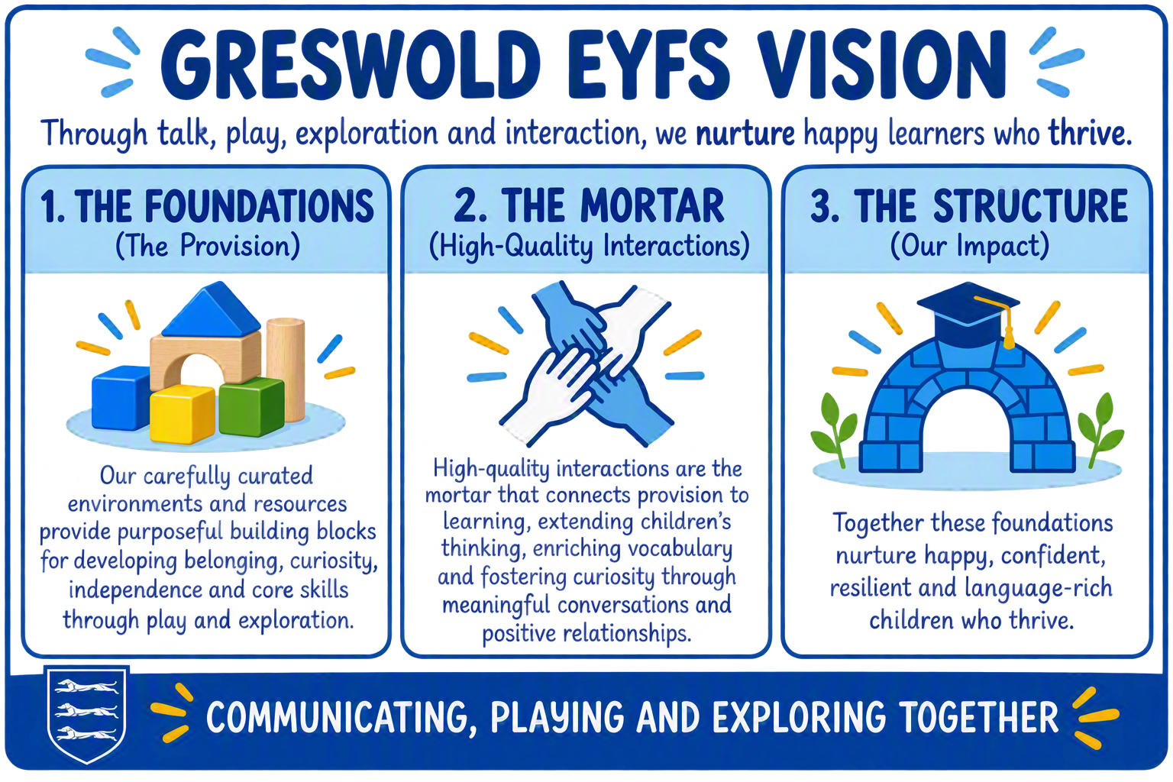
Our EYFS Vision

Slide 3
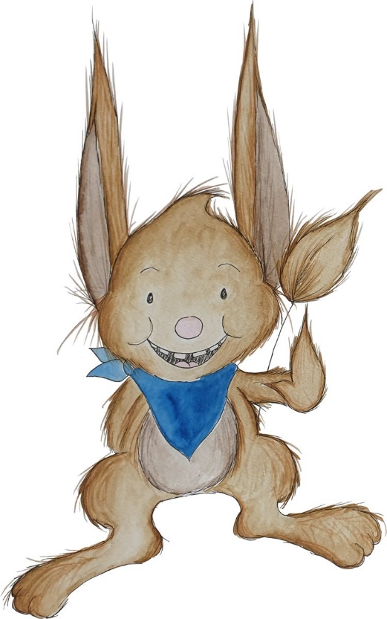
Rhythm of the day
8:30am/12:30pm-The children come in and sit on the carpet for registration, we sing our Hello song and practise our counting. We then go into family groups for Maths and Phonics (Aspect 1-Sound discrimination)
10am/2pm-Snack
11am/3pm-Story.
Home time.

Slide 4


Tapestry and the school App
Does everybody have access to Tapestry? If not, come and see us.
Please feel free to put photographs and videos up! Your child will love sharing these with their friends.
Please make sure that you have signed up to the school app, you will receive messages about school events etc.

Slide 5
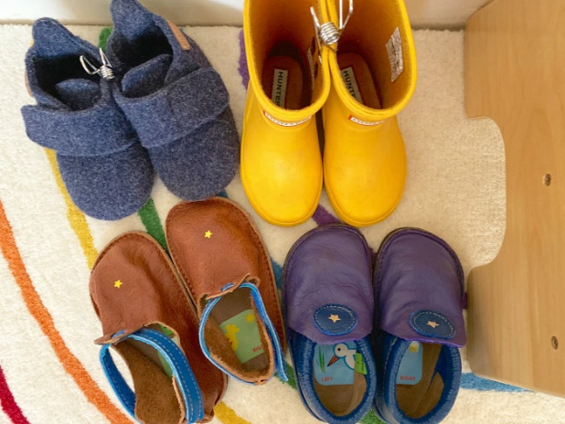
Uniform
Children should be wearing uniform in line with the rest of the school.
Names on everything please.
Coats and wellies.
Please encourage children to be independent, can you encourage them to put their own shoes and coats on themselves.
Passwords.

Slide 6
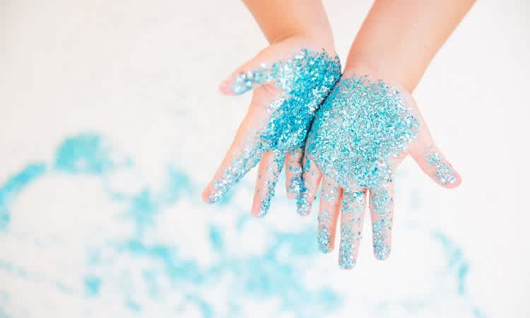
Interests and learning
You will receive a weekly update on Tapestry about what the children have been interested in that week. It will also tell you what aspects of Maths and phonics we will be focusing on.
Keep a look out for the what the interests are, we always love to have parents in to share their skills and knowledge too!

Slide 7
Speech and Language in EYFS
At Greswold, we are placing a strong emphasis on language and communication in the Early Years Foundation Stage (EYFS).
As stated by the Department for Education (2022), "Communication and language is a prime area in the EYFS, meaning it serves as a key foundation for all other areas of development."
Here are some key initiatives:
Book of the Week: Carefully planned selections that focus on key language development.
Talking Time: designed to support language development through small group activities and books, with a universal approach.
Book Share: Launching after half-term to further promote language engagement.

Slide 8

Upcoming events
Parent, Teacher consultations-TBC
Christmas Performances-Mon 30th Nov @ 10.30(M,T,W, am) Wed 2nd Dec @ 2.15 (W,Th,F, pm)

